Slide 1

Movable Radar
Guide:
Dr karan sir
Presented By :
chaitanya
Roll No -231210063
APRIL 2024
NIT Delhi
*
Notes:
*
Chandra prakash

Slide 2
Index
Problem statement
Solution Proposed
About Program
Environment setup/ used
Functions used / created
Result / Outcome
My Learning / Problem Faced
Future Work
Demo
NIT Delhi
*

Slide 3
Problem statement
Design and construct a robotic car which works in both manual mode and automatic mode.
Integrate an upward facing ultrasonic radar on to the cars platform.
Controlling the robot with help of internet using port forwarding.
implement a user friendly webpage for controlling.
NIT Delhi
*

Slide 4
Solution Proposed
In automatic mode, the car operates as an obstacle-avoiding vehicle, navigating its environment intelligently to circumvent obstacles in its path.
This involved carefully selecting a compatible ultrasonic sensor and mounting it securely on the car's chassis, facing upwards
To enable remote control of the robotic car over the internet, we implemented a solution using port forwarding. This involved configuring the ESP32 and Uno to connect to a local WiFi network. By setting up port forwarding on the router.Additionally, we developed firmware for the microcontrollers to establish a web server, allowing users to send commands remotely.
As part of enhancing user experience, I designed and developed a user-friendly web interface for controlling the robotic car. This involved creating a responsive web page using HTML, CSS, and JavaScript.
NIT Delhi
*

Slide 5
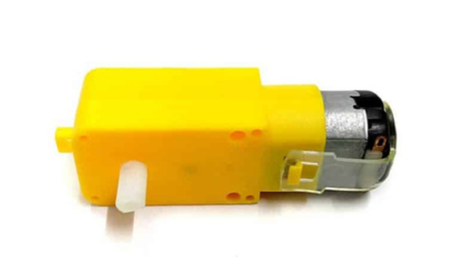
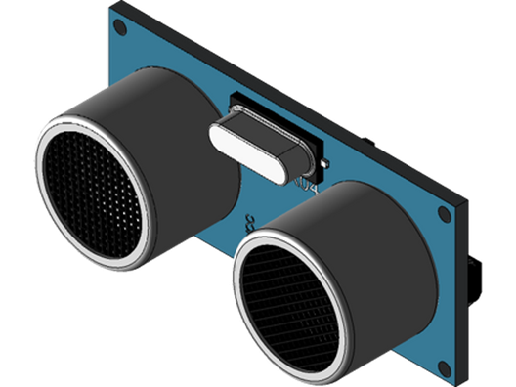
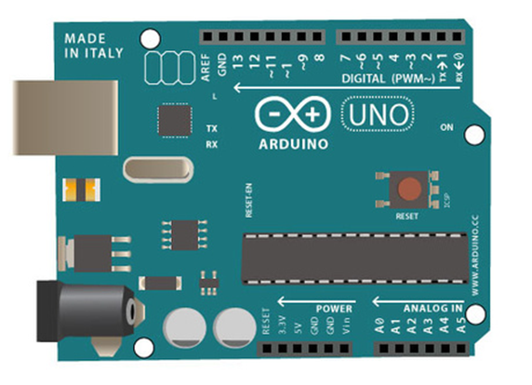
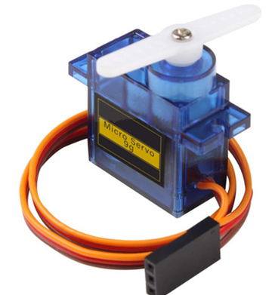
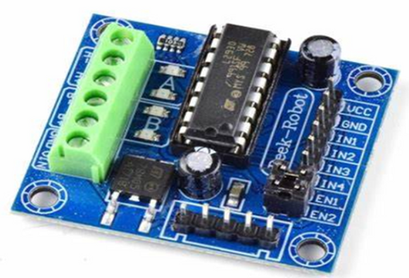
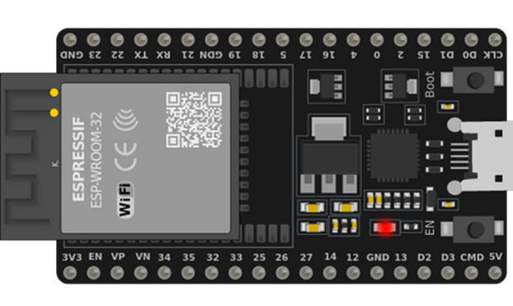
Components
Ultrasonic Sensor
DC motor
Arduino UNO
ESP 32
Servo Motor
Motor Driver
NIT Delhi
*

Slide 6
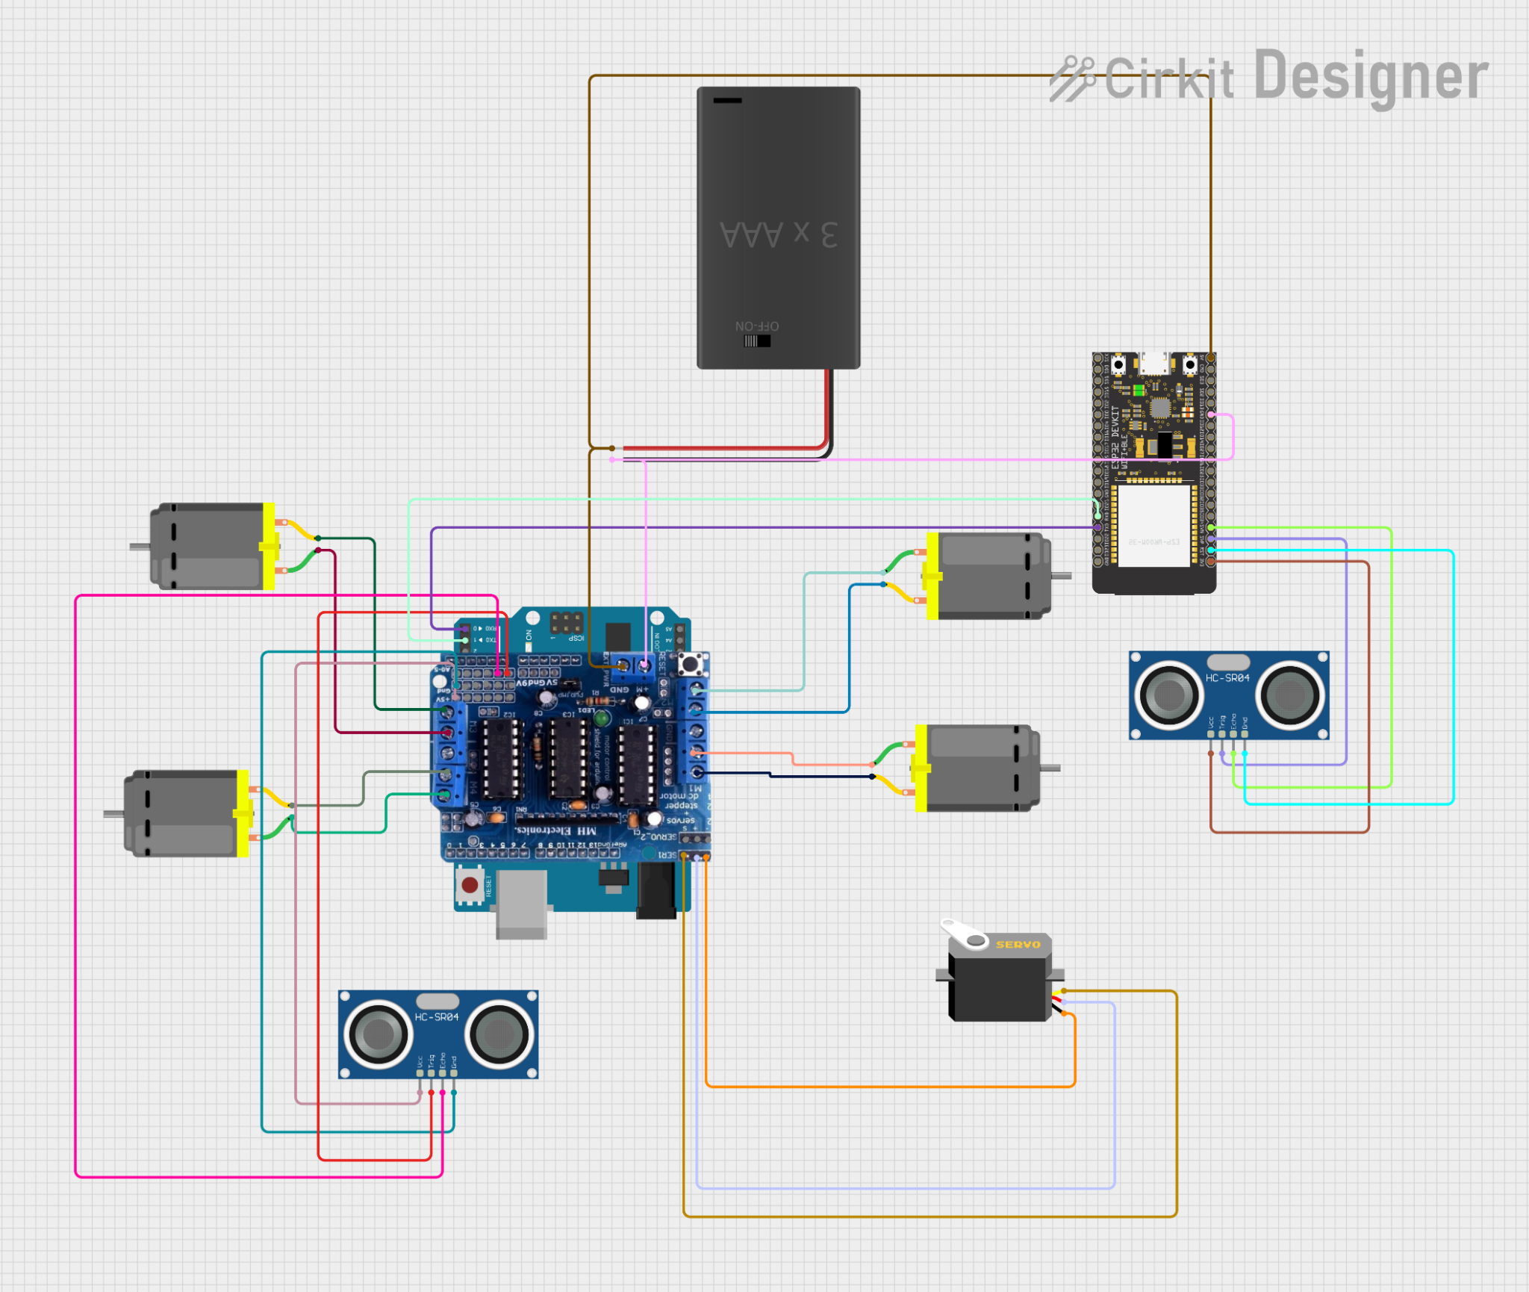
Circuit diagram
NIT Delhi
*

Slide 7
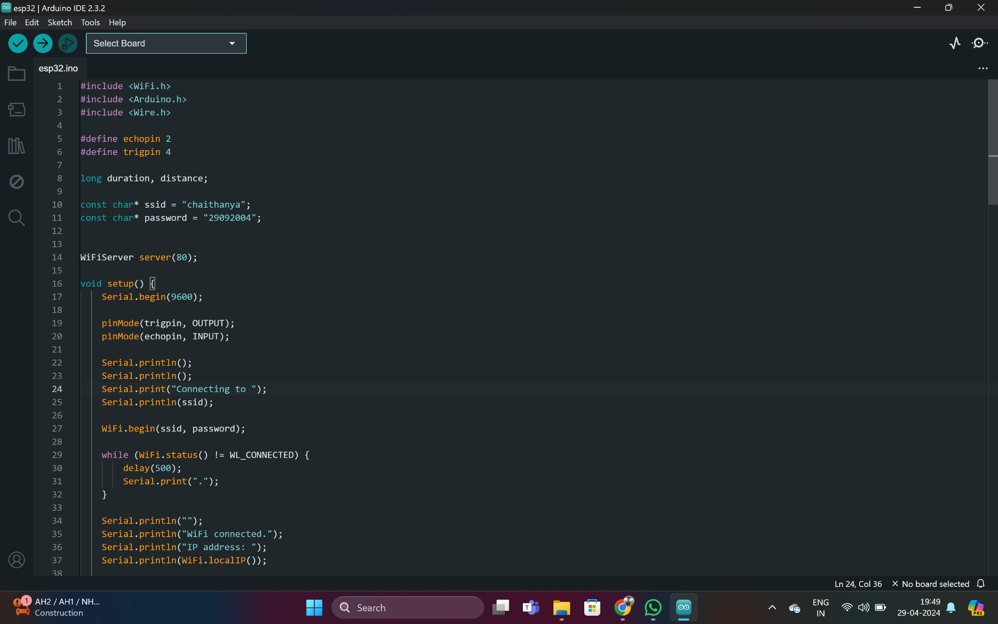
About Program
esp 32 code
NIT Delhi
*

Slide 8
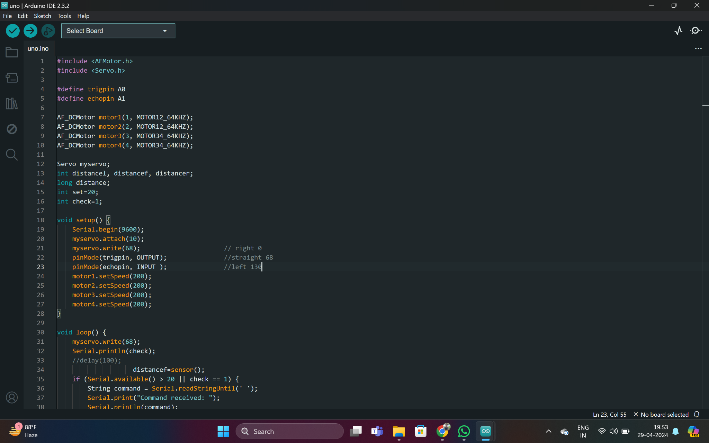
About Program
uno code
NIT Delhi
*

Slide 9
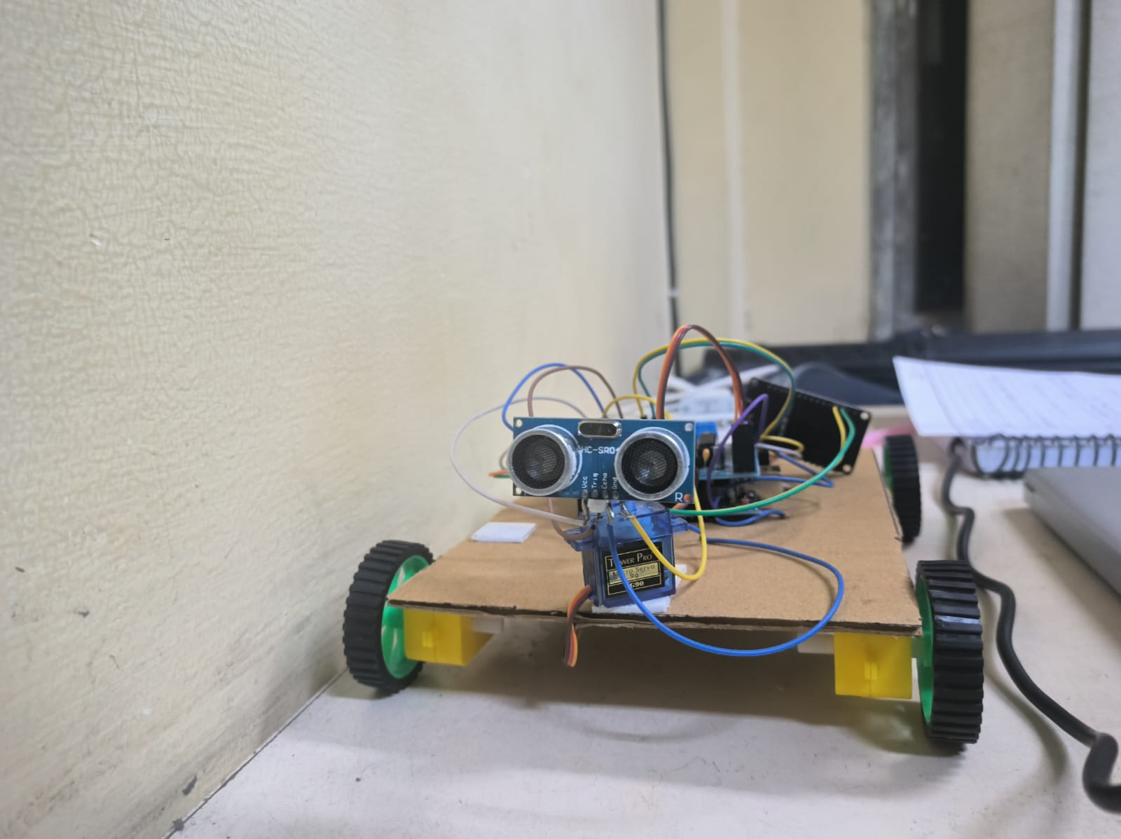
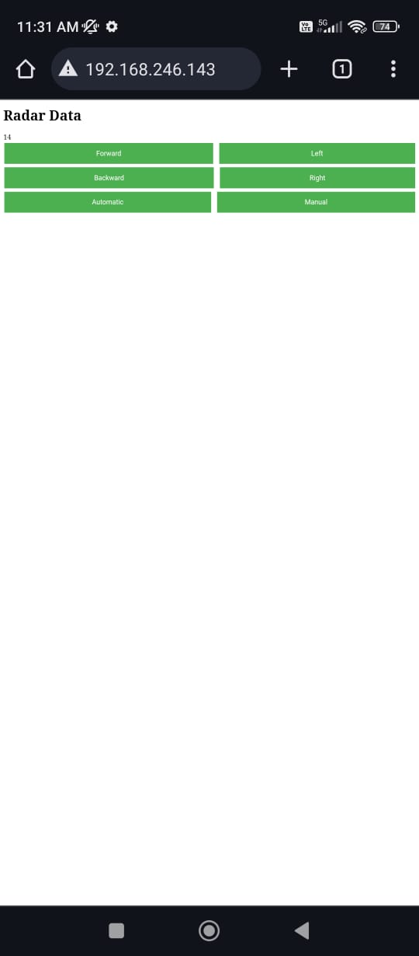
Result/ Outcome
NIT Delhi
*

Slide 10
My Learning
Electronics:we have learned about basic electronic components like motors, sensors, microcontrollers and power sources.
Mechanical Design:we have learned about the principles of mechanical engineering, including how to ensure stability, durability, and functionality.’
Motor Control: Controlling the movement of the car requires understanding so i have learned how to interface motors with your microcontroller.
Sensors Integration:we have learned about sensor selection, data interpretation, and integration with the control system.
Programming: As we have used Arduino, learned programming concepts like variables, loops, conditionals, and functions. For autonomous functionality, I delve into algorithms for pathfinding and decision-making.
Integration of Manual and Automatic Modes: we have learned to design a user interface and implement logic to switch between modes seamlessly.
Testing and Troubleshooting: Throughout the project, i have encountered many challenges and bugs that require troubleshooting.So i have learned how to diagnose problems in much better way
NIT Delhi
*

Slide 11
Future Work
An exciting future implementation involves integrating a camera onto the car, enabling remote navigation by live video feed. This enhancement would allow users to remotely control the car's movements by observing the real-time video captured by the onboard camera.
Obstacle Avoidance Optimization- Fine-tune the obstacle avoidance algorithms to make them more robust and responsive.
Port Forwarding- We can do port forwarding with the help of Wi-Fi router to control the car from anywhere.
In the future, we plan to make the radar movable, giving the car the ability to scan its surroundings from different angles
Energy Efficiency Optimization-Explore ways to optimize the car's energy consumption to extend its battery life or increase its range. This could involve optimizing motor control algorithms, implementing regenerative braking, or integrating energy harvesting technologies.
NIT Delhi
*

Slide 12
References
Arduino. (n.d.). SimpleWiFiServer. Retrieved from https://www.arduino.cc/en/Tutorial/LibraryExamples/SimpleWiFiServer
OpenAI. (n.d.). ChatGPT. Retrieved from https://openai.com/chatgpt
NIT Delhi
*

